Slide 1
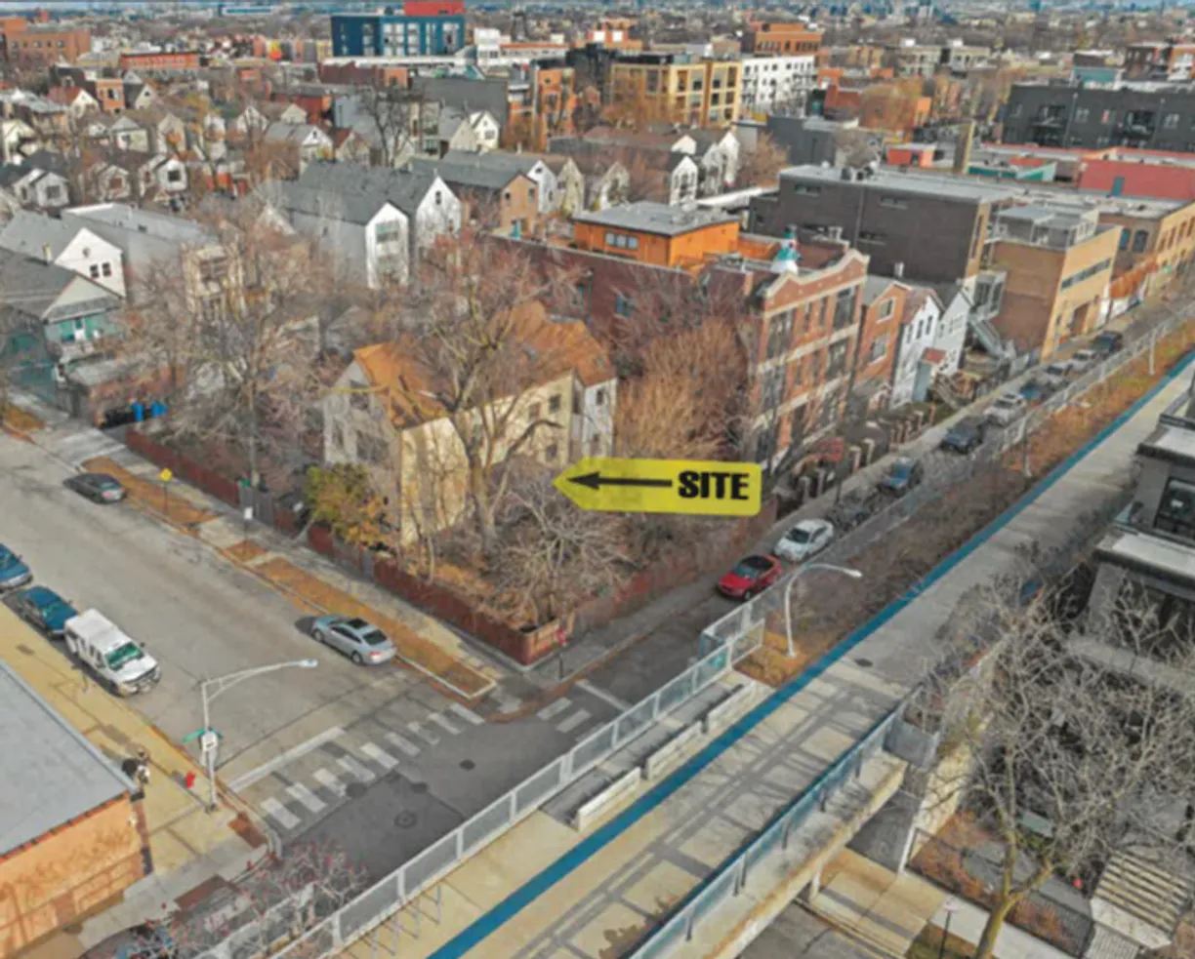
1805 N Campbell

Slide 2
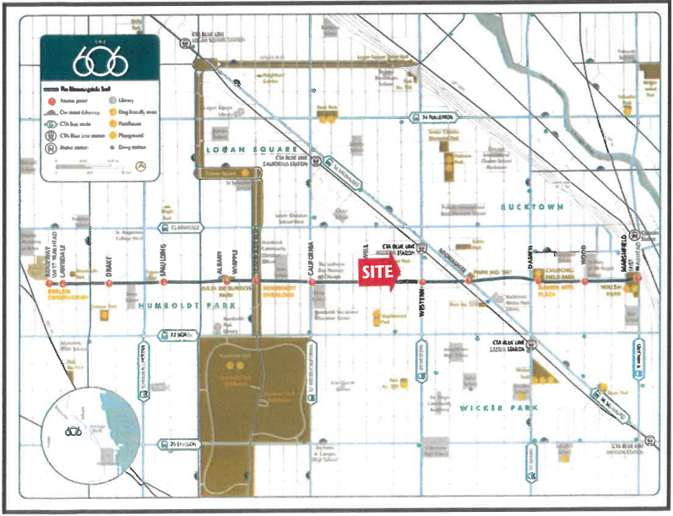
Area Map

Slide 3
Four Story Building
First Floor: 10 Parking Spaces and 3 Residential Units
Floors 2-4: Six Residential Units Each
21 Total Units
No Yard Relief- All Yards “Per Code” (No Variances)
Transportation Oriented Development
Building Summary

Slide 4
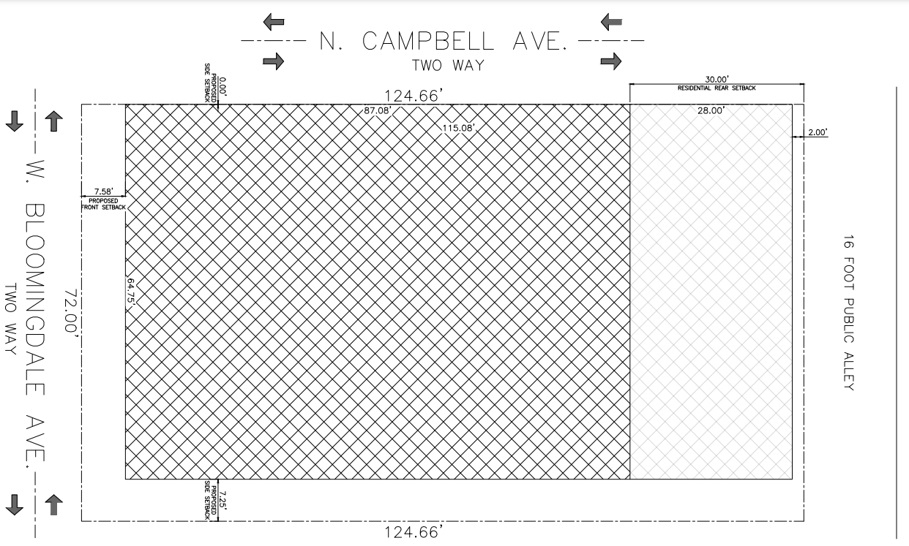
Site Plan

Slide 5
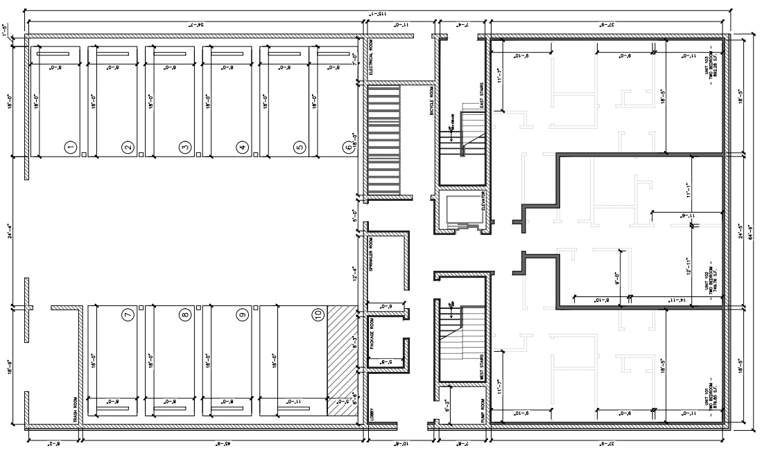
First Floor- 10 Parking Spaces and 3 Residential Units

Slide 6
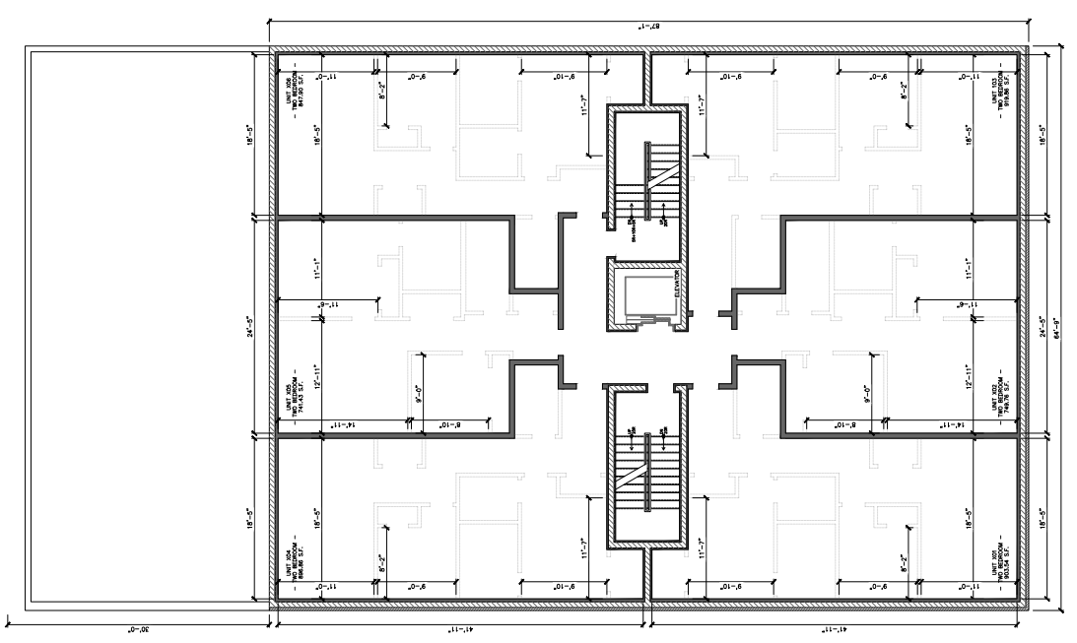
Floors 2-4-Six Residential Units Each

Slide 7
Dwelling Unit Analysis

Slide 8
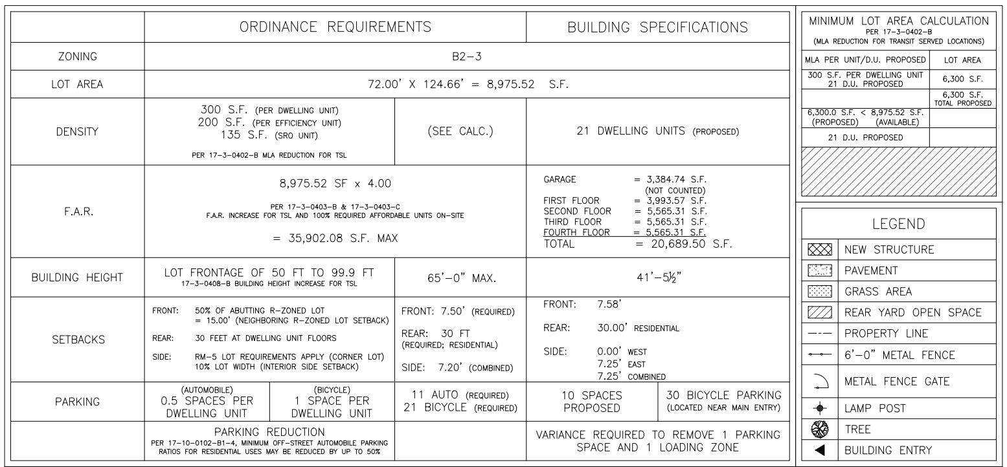
Zoning Summary

Slide 9
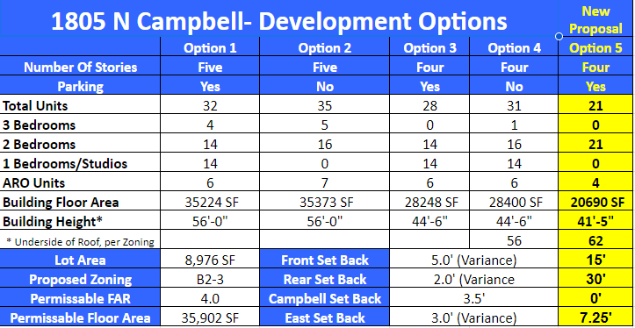
Proposal Comparison

Slide 10
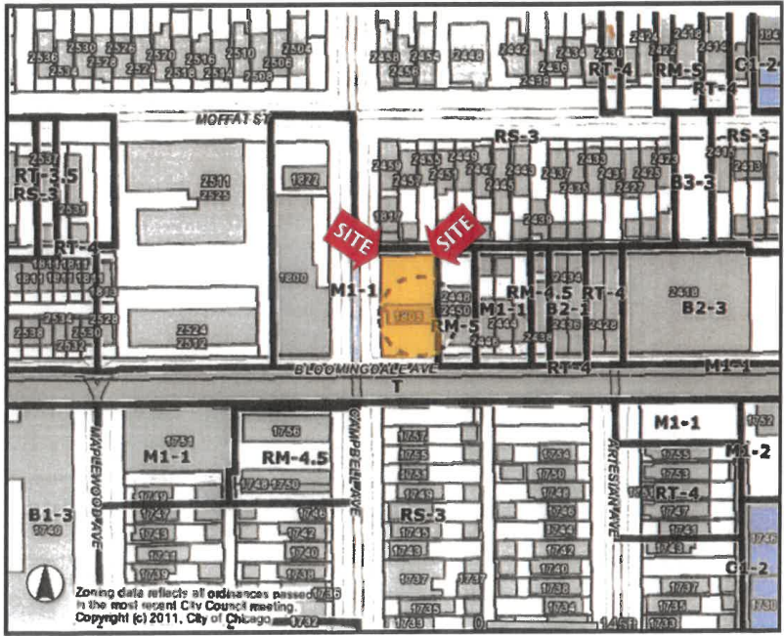
Zoning Map

Slide 11
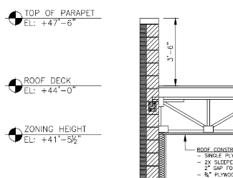
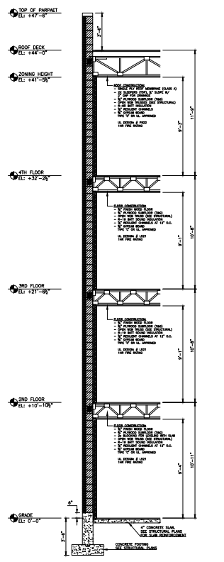
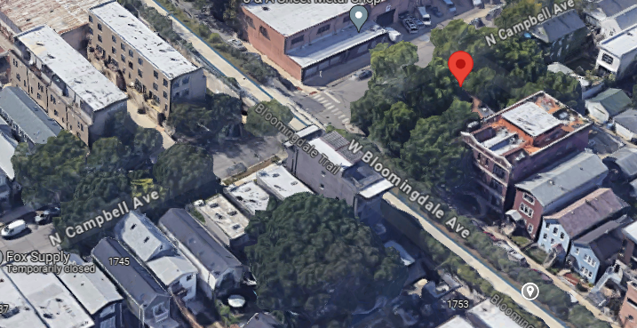
1805 N. Campbell:
Proposed Top of Parapet-47’6”
2448-50 W. Bloomingdale (Adjacent Building):
Top of Parapet-45’8”
1748-56 N. Campbell (Kitty Corner Townhomes):
Top of Parapet-43’6”
Height Analysis

Slide 12
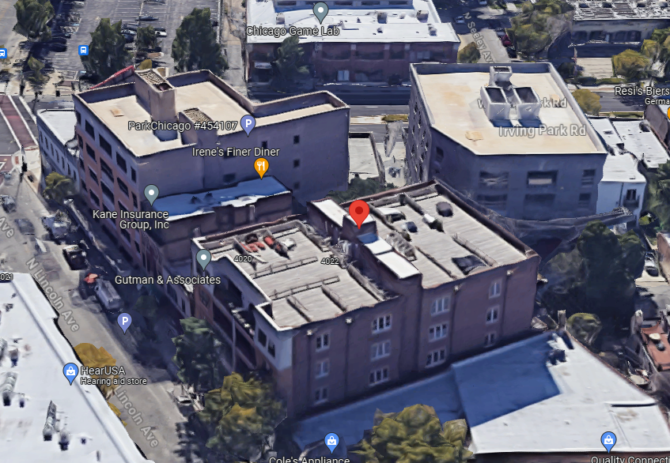
View of Top of Building

Slide 13
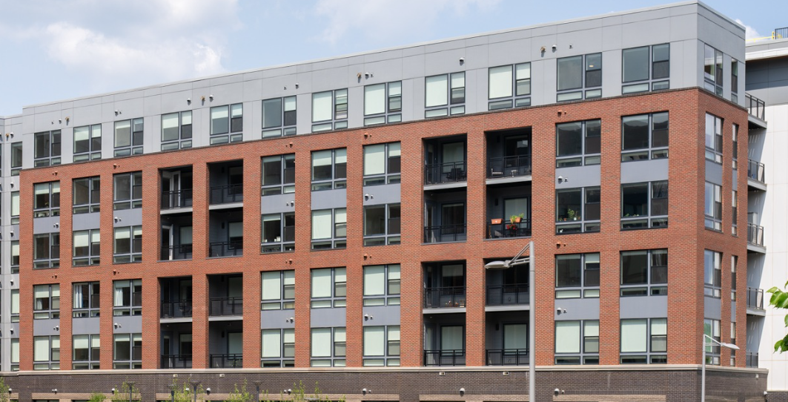
Design Inspiration -www.rylantysons.com
(Elevations will be developed after floor plans are determined)

