Slide 1


2101-03 West Chicago Avenue
Proposed Addition to the Existing
Mixed-Use Building
Proposed addition to the existing mixed-use building
z
November 2, 2020

Slide 2

Developer’s Team
Owner / Applicant:
Kasia's Deli, Inc. / 440 N. Oakley LLC.
2101-03 West Chicago Avenue, Chicago IL
Architect:
Red Architects
Attorneys:
Law Office of Mark J. Kupiec & Assoc.
Mark Kupiec and Agnes Plecka

Slide 3
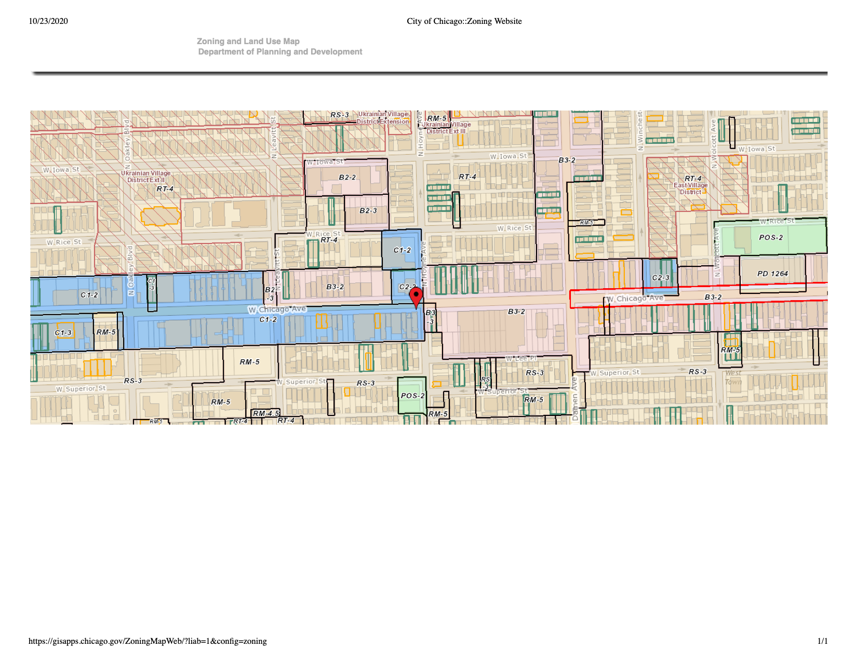

Zoning Map

Slide 4
Existing Conditions at the Property
Existing 3 buildings: a 3-story mixed-use building with 4 dwelling units at the 2101 front, a residential building with 1 dwelling unit at the rear of 2101 and one-story building at 2103. Currently there are 5 dwelling units total.
The existing commercial unit has been housing a well-known deli - Kasia’s Deli, which has been operating at this location for over 38 years.
The property currently has no on-site parking.

Slide 6
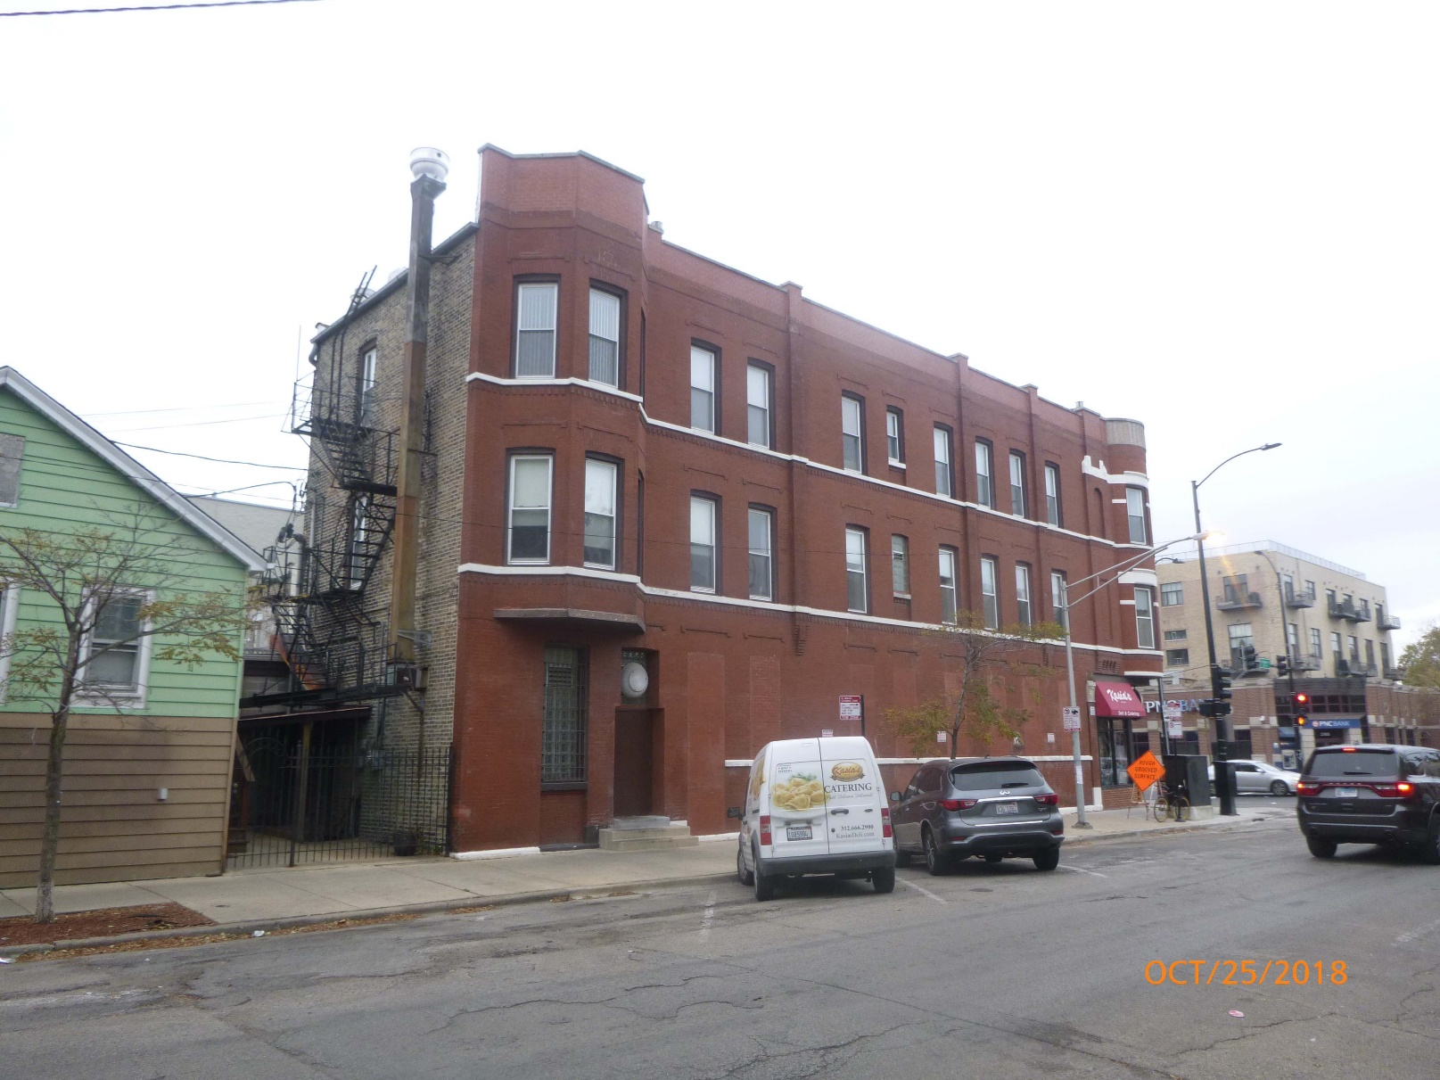
Subject Property – Existing 3-Story Mixed-use Building (front) and a Residential Building (rear)

Slide 7
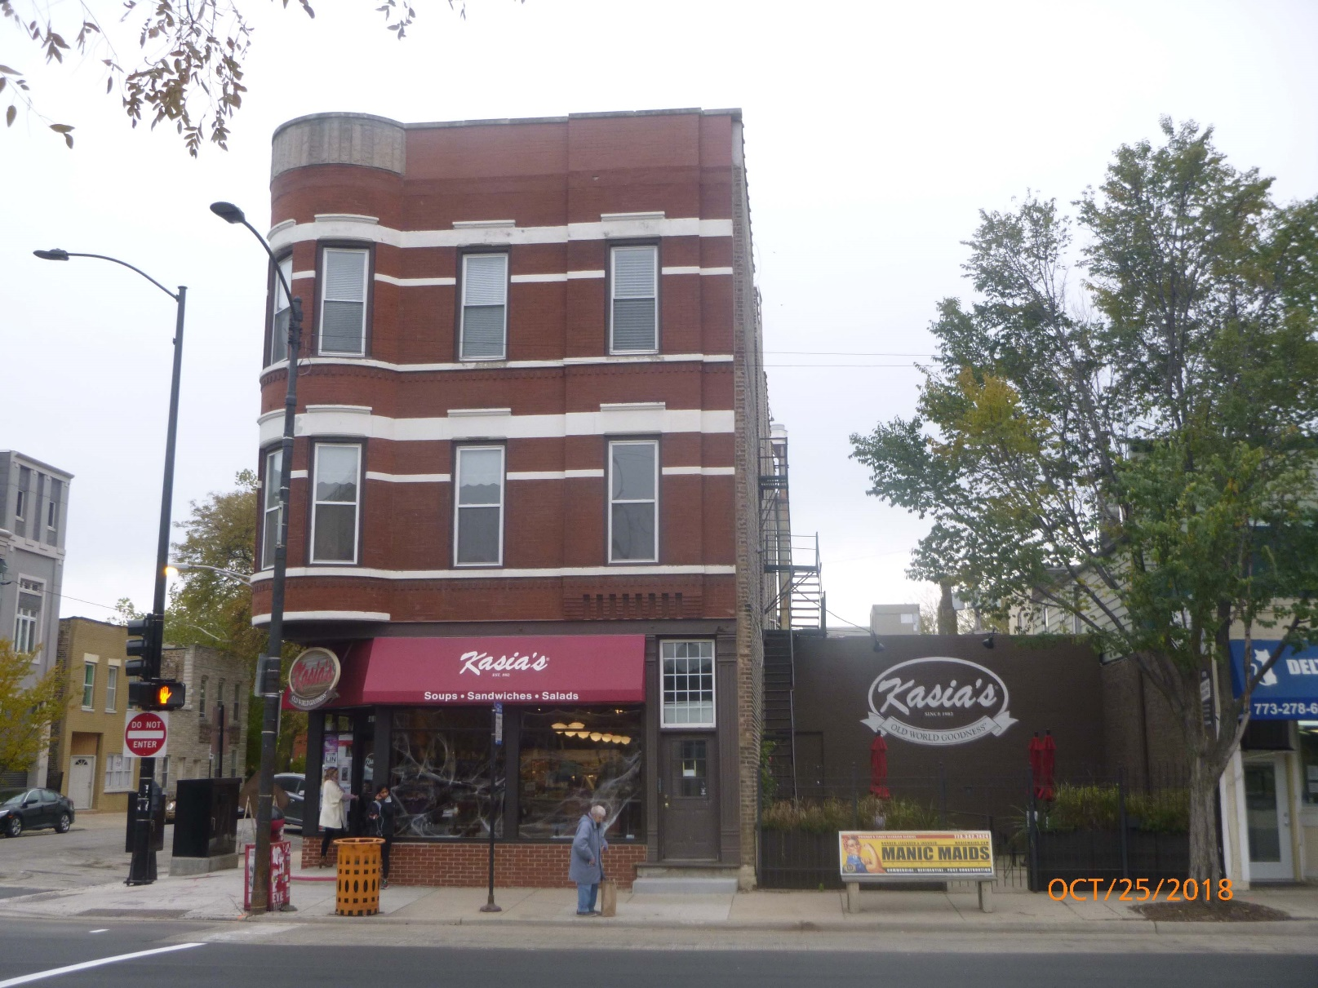
View from Chicago Avenue

Slide 8
ZONING CHANGE REQUEST | C1-2 to C1-3
PROJECT DESCRIPTION
The Applicant wishes to preserve and rehab the existing building but also to be able to expand its business which occupies the ground floor.
The Applicant intends to build a 3-story side addition to the existing building with ground floor commercial and 3 new dwelling units on the upper floors of the proposed addition for a total of 7 dwelling units at the property.
The existing rear building will be demolished and replaced with 5 parking spaces.
The Applicant needs a zoning change in order to comply with the minimum lot area and the maximum floor area requirements of the Zoning Ordinance.

Slide 9
Transit Oriented Development
The subject property is located within close proximity to the CTA Rapid Transit:
Blue Line station at Division and Chicago is within 1 mile;
Green Line station at Ashland is within 1 mile;
The property is located along the Chicago Avenue Bus Corridor

Slide 10
Proposed Rezoning Compatible with Current Development Trends in the Neighborhood
Compatible with recent zoning changes in the subject neighborhood (multiple -3 densities in the area)
Compatible with other existing multi-story / multi-unit residential buildings (4-story building at 2113-15 W. Chicago, 4-story building at 2116 W. Chicago, 4-story buildings at 2048-54 W. Chicago, and 3-story buildings at 2117-33 W. Chicago.

Slide 11
Community Benefits
The Applicant is a local business owner, who has operated at this location for almost 40 years;
Proposed addition will allow an expansion of this well-known business in the neighborhood providing essential retail food services;
This development will be pedestrian friendly;
Will generate real estate and sales tax revenue for the City.
The Applicant expects to be able to create additional jobs related to this business.

Slide 12
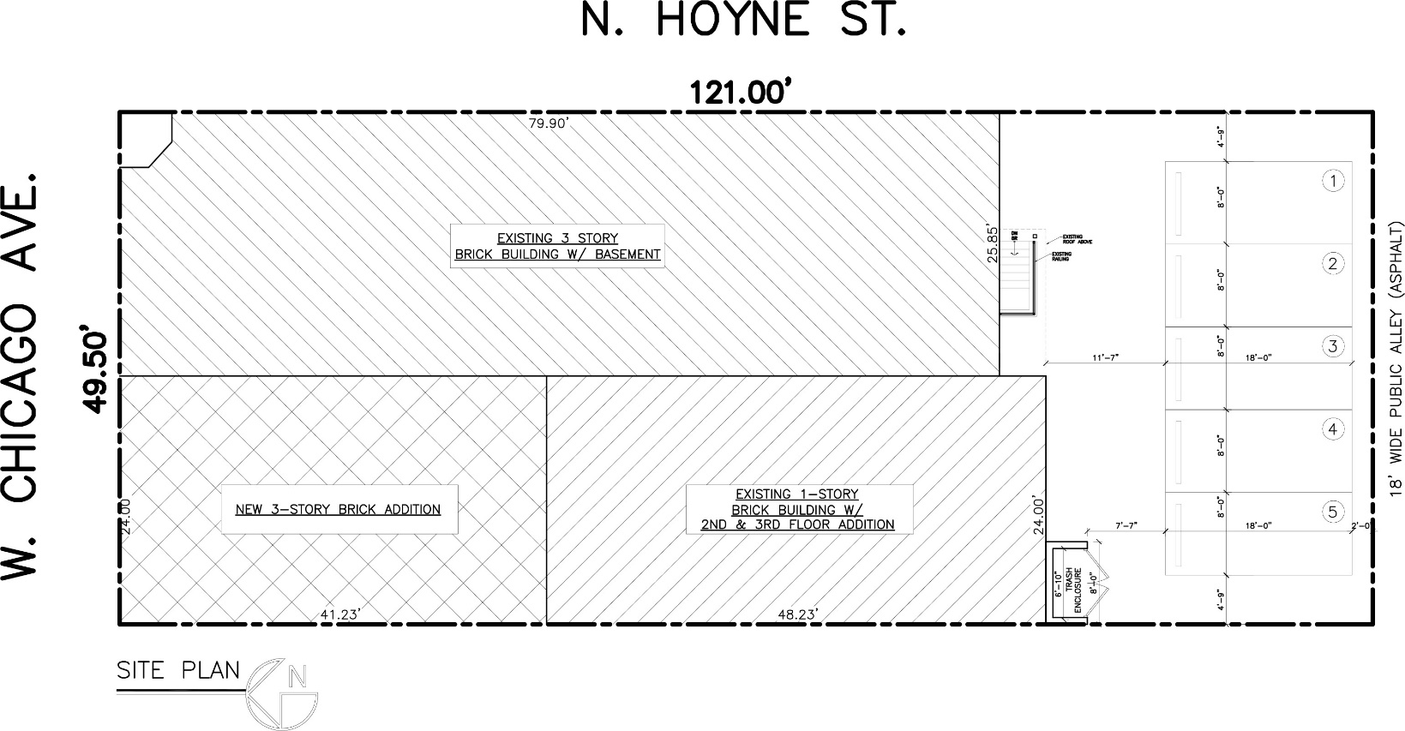
Proposed Site Plan

Slide 13
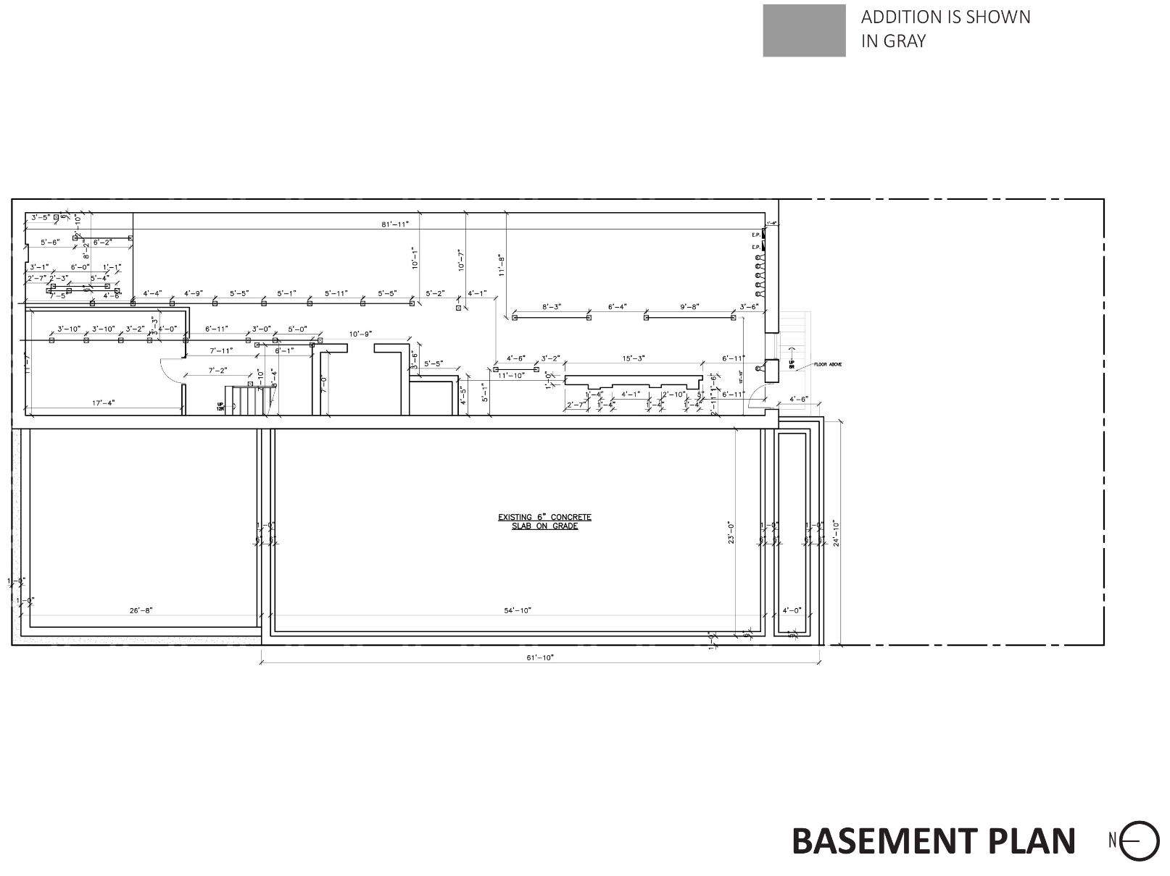
Floor Plans

Slide 14
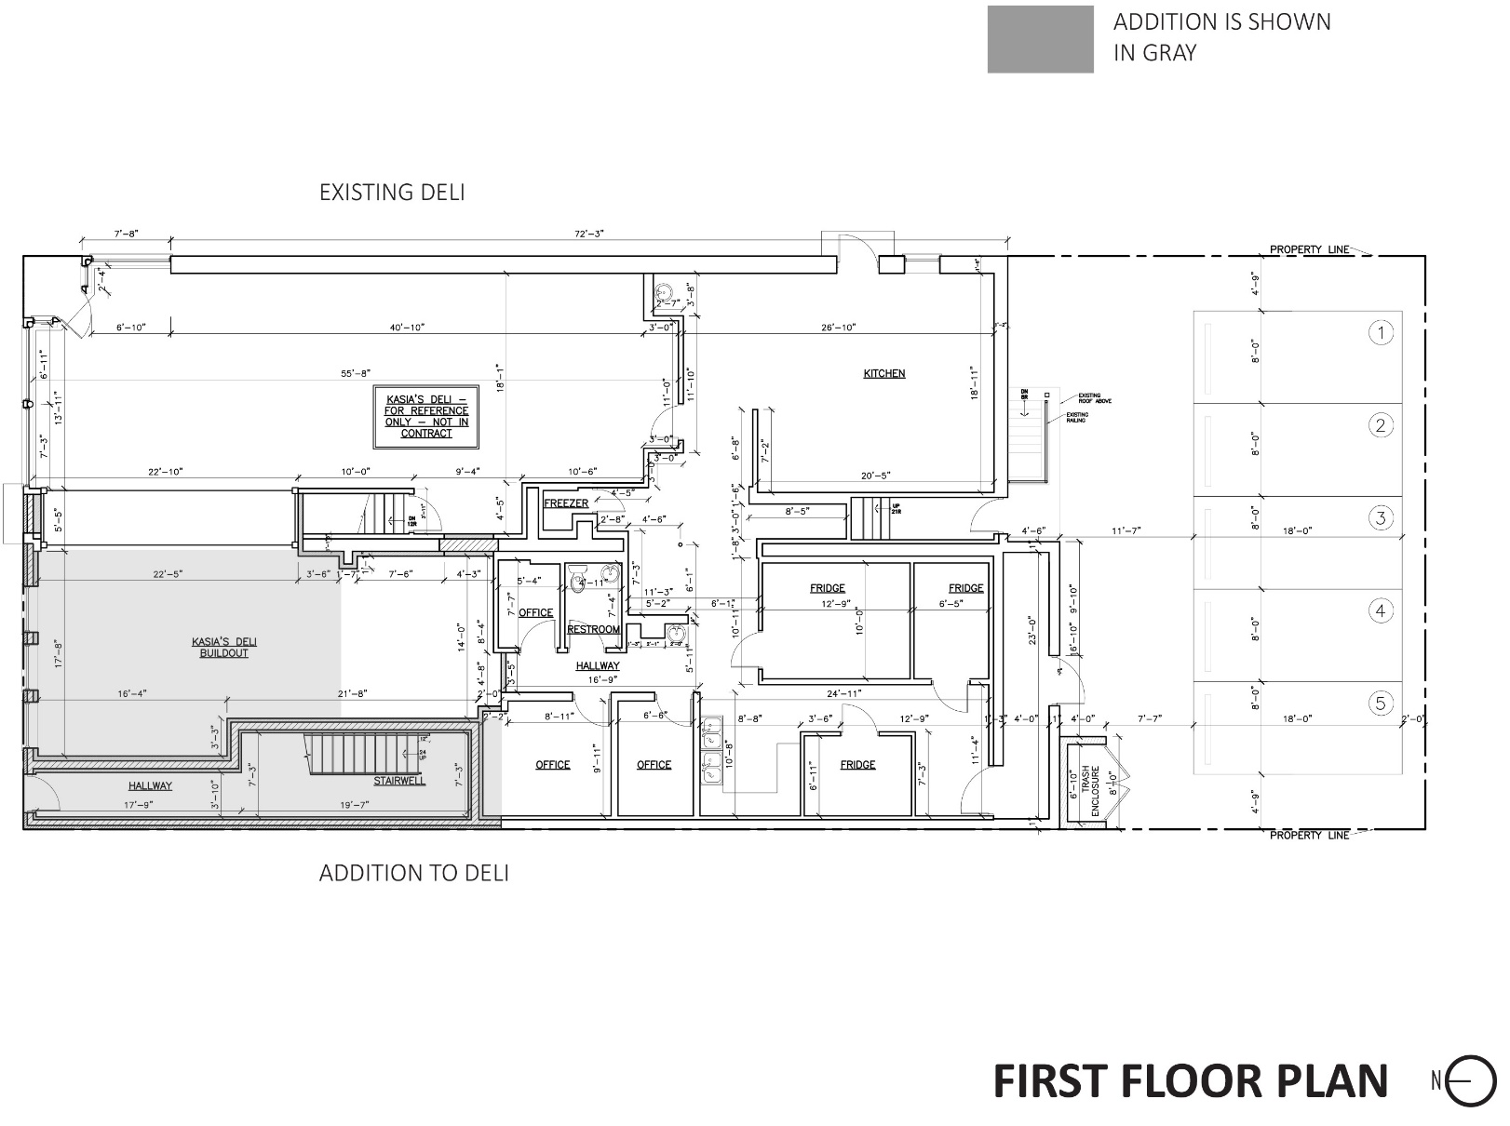
Floor Plans

Slide 15
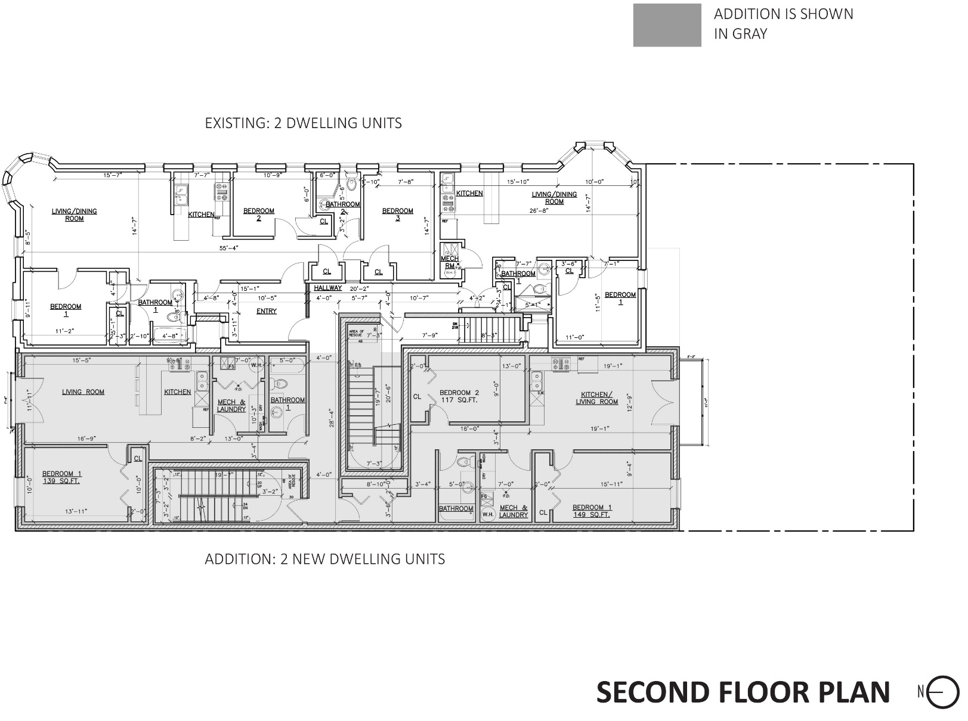
Floor Plans

Slide 16
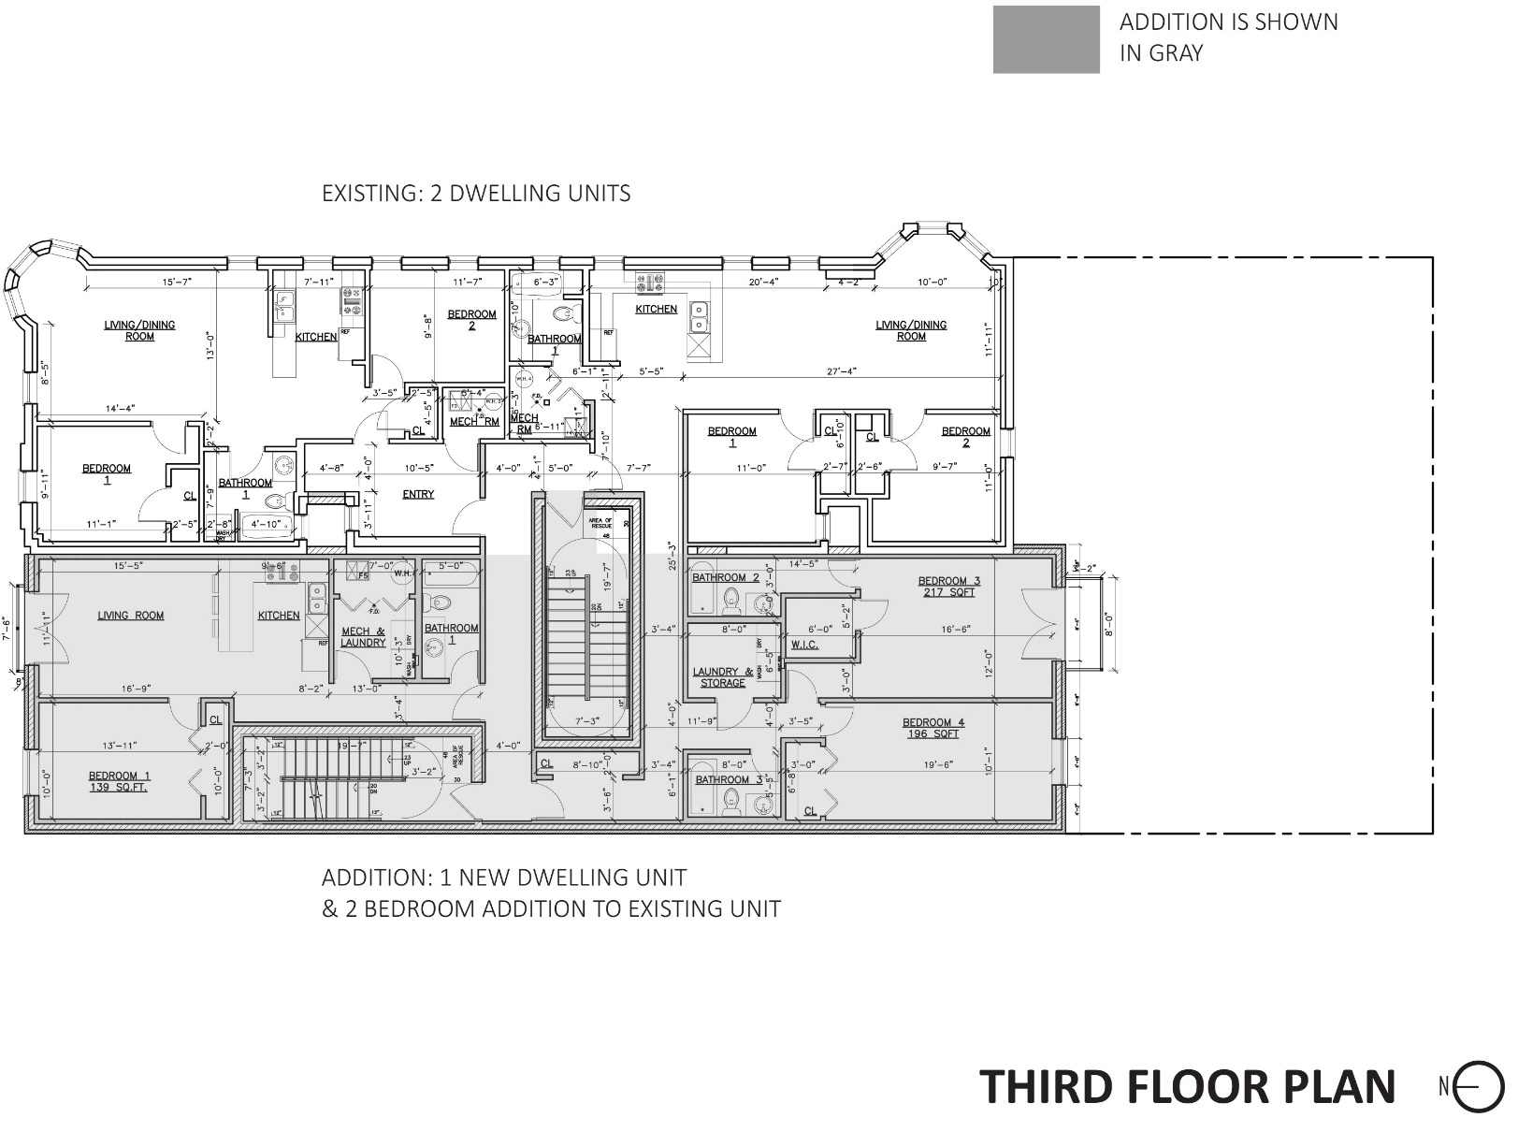
Floor Plans

Slide 17
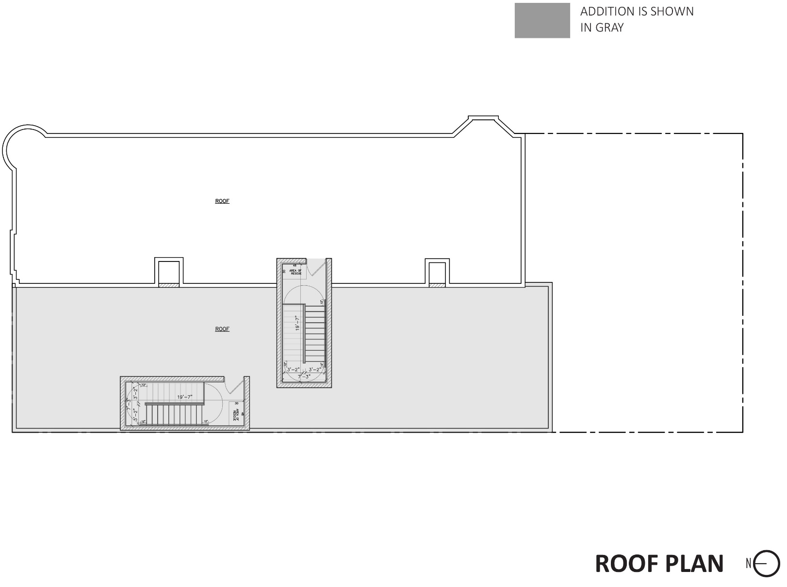
Floor Plans

Slide 18
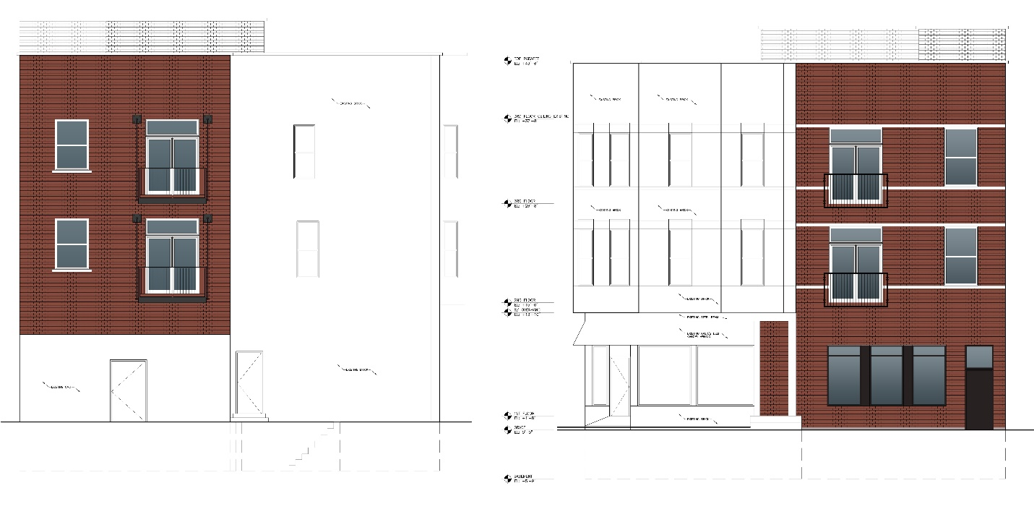
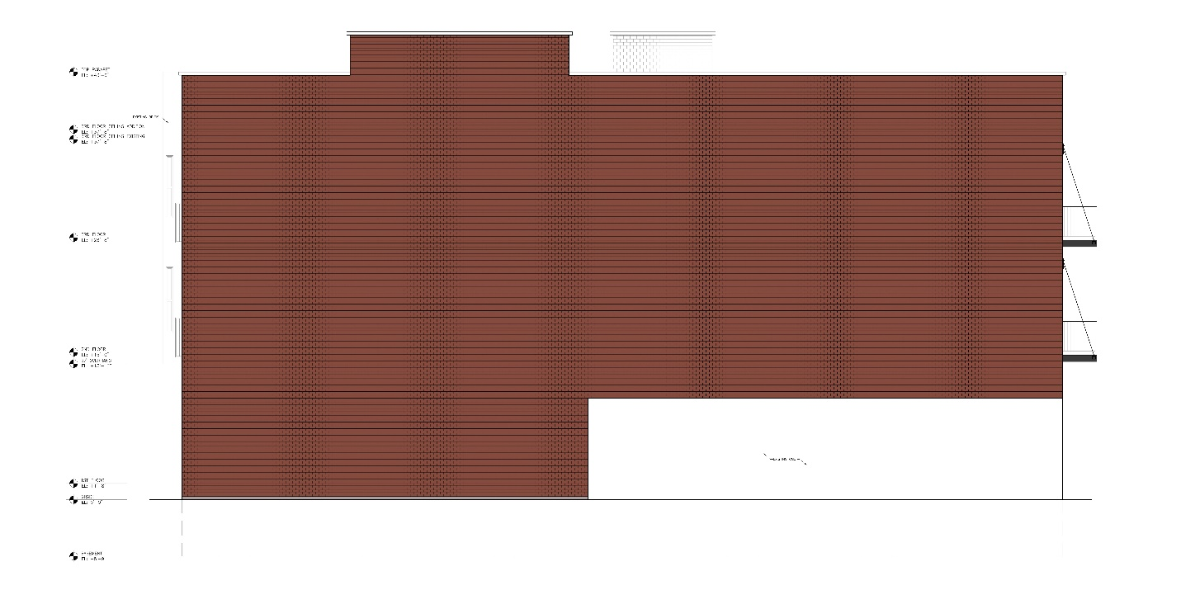
Elevations
Rear Elevation
Front Elevation
Side (West) Elevation

